Slide 1





Characterizing Potential Long-Term Downstream Flooding Hazards Post-Asteroid-Impact
Lucienne S. Morton, Timothy N. Titus, Kaj E. Williams
Partial funding from the USGS Astrogeology Science Center and NSF through NAU Astronomy & Planetary Science REU

Slide 2
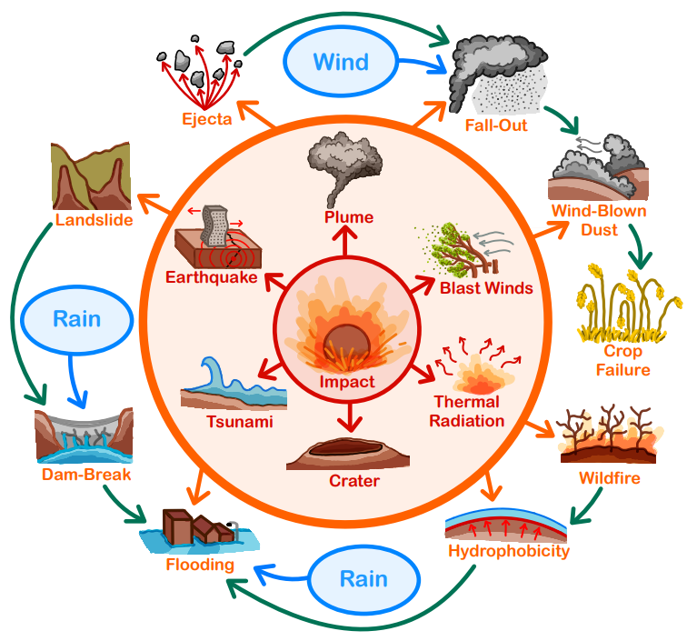
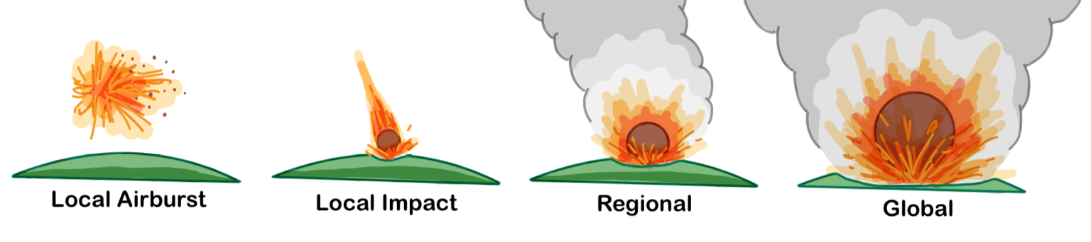
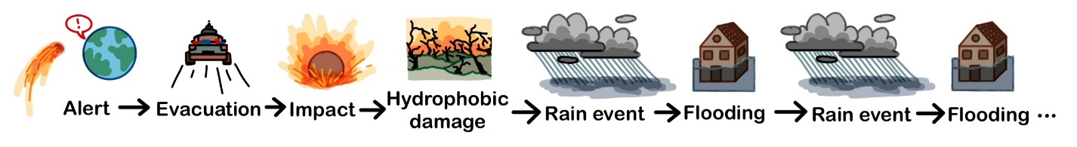
Background
As asteroid size increases, impact frequency decreases
Most current research focuses on initial impact effects
  Immediate and diminish in severity with distance
Our lack of direct experience with impact events leaves a
knowledge gap of the long-term recovery
  Our predictions:
    The initial effects will trigger a cycle of secondary effects
    The influence of weather leads to climate-coupled effects
    Analogs to natural hazards can help estimate these cascading hazards
Using the wildfire-flood sequence as an analog, we predict downstream flooding may occur post-asteroid-impact

Slide 3
Our Project
Create a simplified model to estimate total exposed and affected population in various hypothetical impact scenarios
Determine the influences of:
  Impact location
  Hydrophobic radius size (a function of asteroid mass)
  Rainfall intensity
Hazard Characterization
Flood Model
Simulated water depth and flow velocity data
Affected Population
Model output compared to population data as an assessment of hazard severity
Mitigation Strategies
Hazard analysis pipeline developed for integration to future defense planning
DEM
Topography map over studied area
How sensitive is the number of people affected from post-impact flooding to these factors? Are these flood hazards significant? When/where does flooding become a threat?

Slide 4
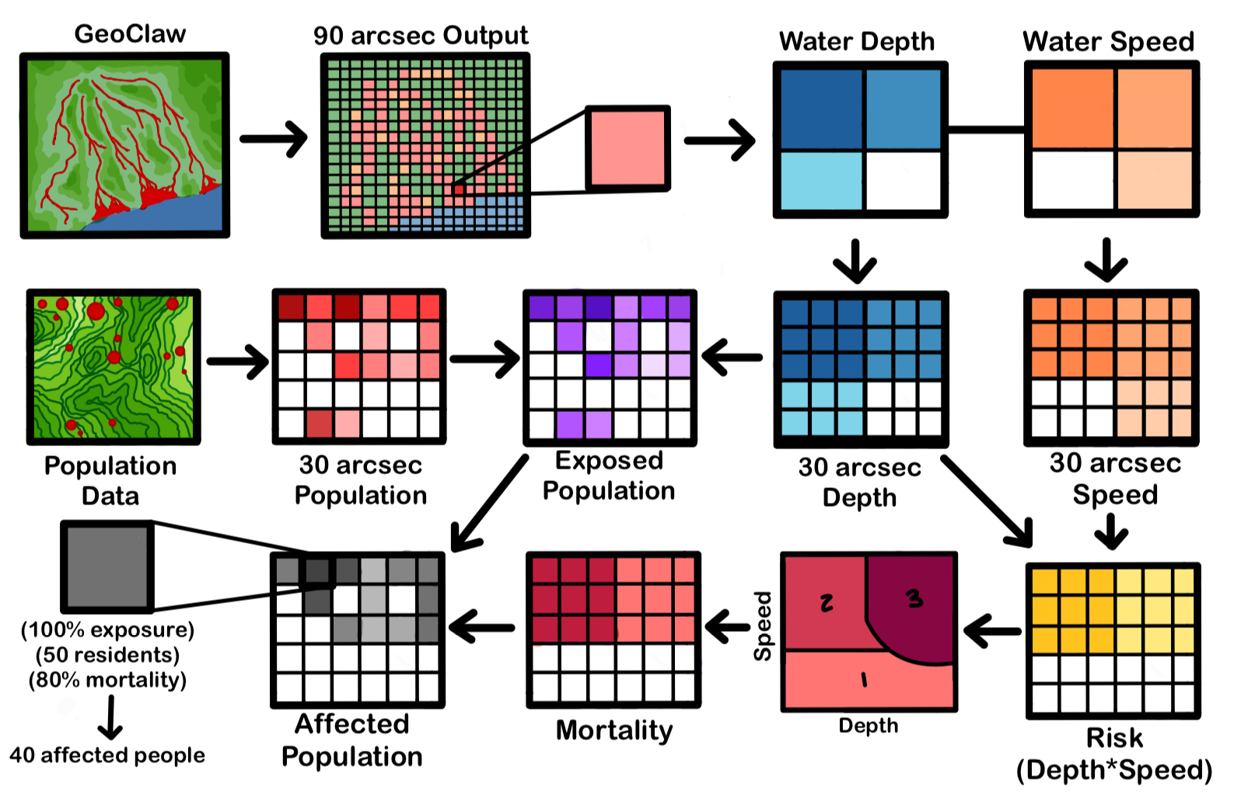
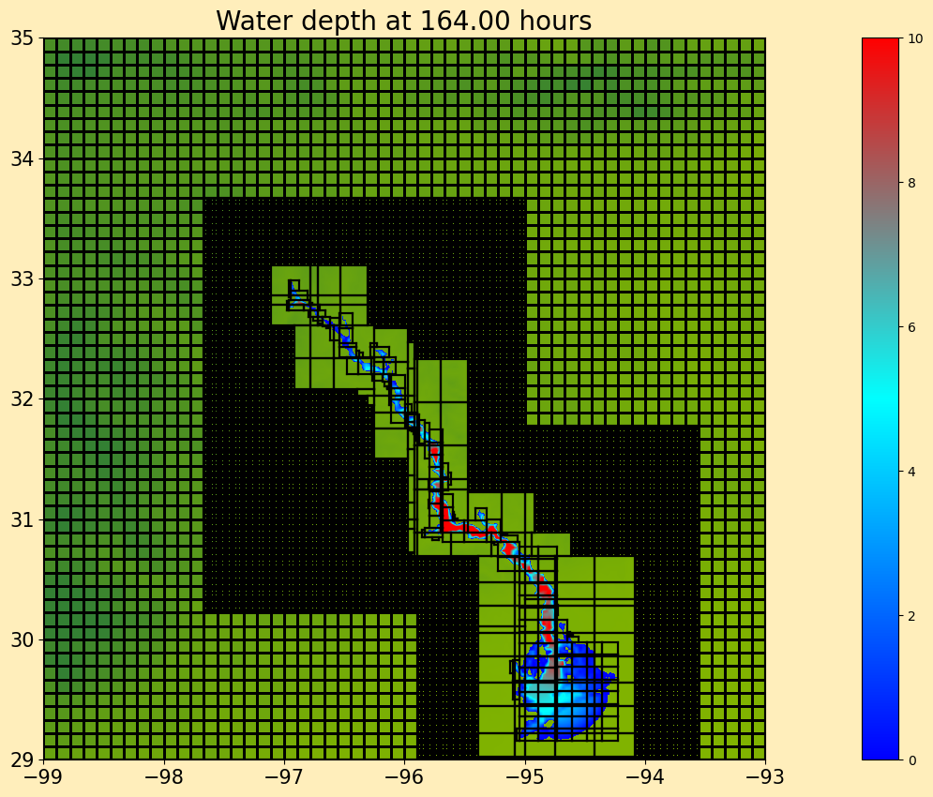
Methodology
GeoClaw:
Open-source model that simulates geophysical flows
  Solves the 2D depth-averaged shallow water equations
Caveats
  Does not model precipitation
    Point-source (spring) is used
  Lack of base flow, infiltration, sediment flux, evaporation, transpiration, etc
Post-Processing:
Resolution change: 90” output compared to 30” population
Exposed population: people experiencing any level of flooding
Affected population: how many fatalities will occur

Slide 5
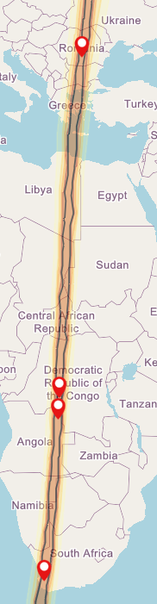
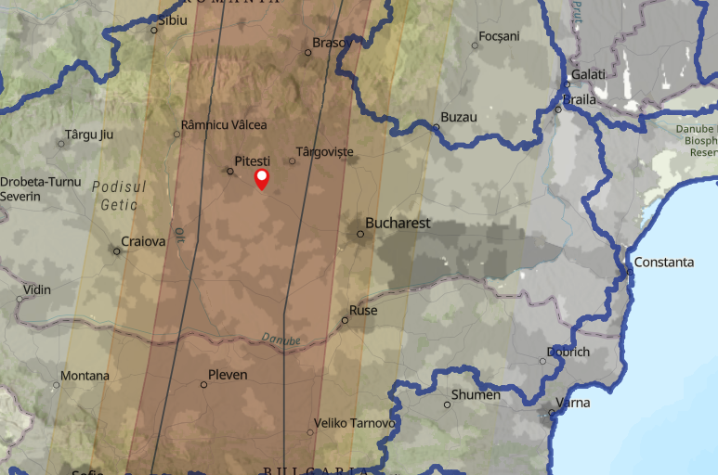
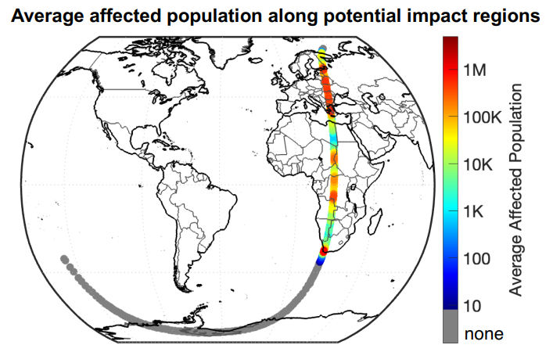
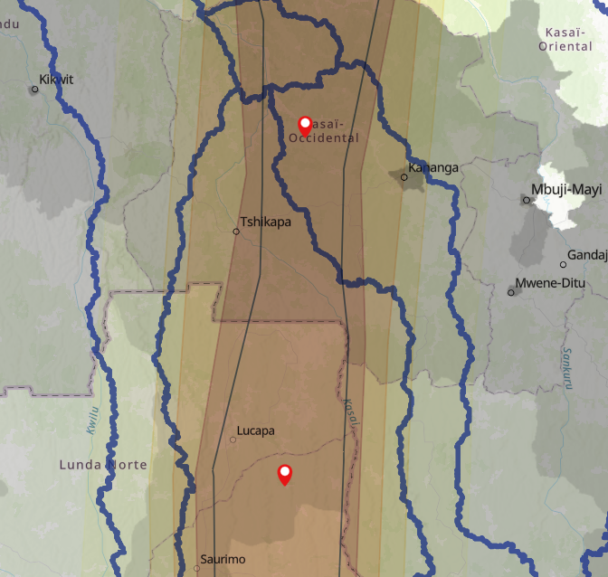
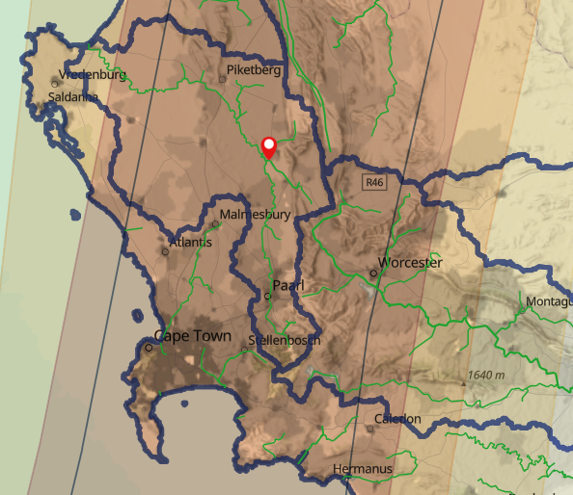
Our Scenario
Our Cases:
Four locations with varying topography and population distribution
Most Likely (MLC): average daily rain for 3 days over 25 km radius
Worst (WC): 10x average daily rain for 3 days over a 50 km radius
HYPOTHETICAL EXERCISE ONLY
Romania
DR Congo
Derived from 2025 Planetary Defense Conference (PDC)
Asteroid properties:
  Date: April 24, 2041
  Diameter: 90 - 160 m
  Impact energy: 5 - 70 Mt
  Thermal damage radius: 0 – 60 km
Tsar Bomba: 50 – 58 Mt
Location | MLC Flow Rate (m^3/s) | WC Flow Rate (m^3/s)
South Africa | 200 | 9000
Angola | 400 | 14000
DR Congo | 800 | 34000
Romania | 300 | 12000
Angola
South Africa

Slide 6
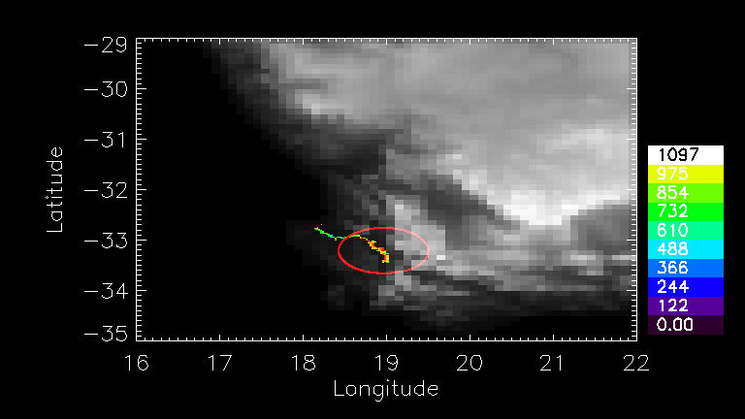
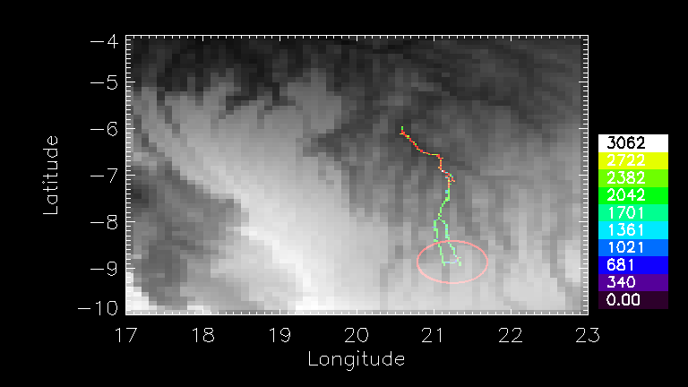
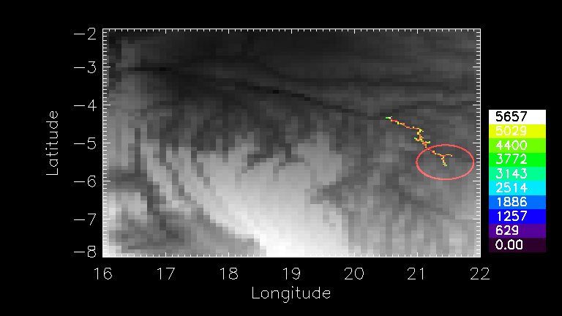
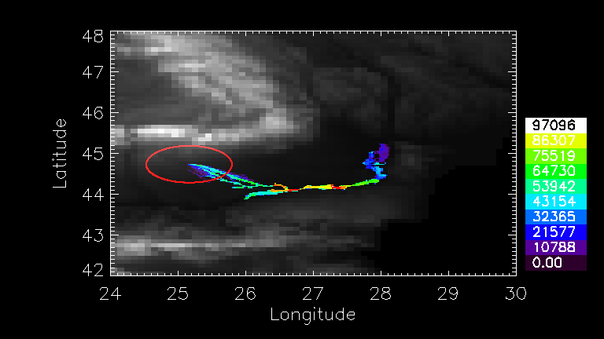
Results
 | Most Likely Case (R = 25 km) |  |  |  | Worst Case (R = 50 km)
Location | Total Exposed Population | Total Affected Population | % of Total Exposed Outside R | % Affected of Total Exposed | Total Exposed Population | Total Affected Population | % of Total Exposed Outside R | % Affected of Total Exposed
South Africa | 11,470 | 7,929 | 0 % | 69.13 % | 63,361 | 56,038 | 4.40 % | 88.44 %
Angola | 60,133 | 53,237 | 50.28 % | 88.53 % | 979,131 | 914,329 | 94.58 % | 93.38 %
DR Congo | 242,795 | 229,882 | 55.50 % | 94.68 % | 1,236,770 | 1,221,140 | 70.71 % | 98.74 %
Romania | 2,240,640 | 338,666 | 99.86 % | 15.11 % | 20,033,700 | 13,064,700 | 99.54 % | 65.21 %
South Africa
South Africa
  Lowest exposed and affected populations
  < 5 % of exposure occurs outside of R
Angola
  Water extends far downstream
  50 – 95 % of exposure occurs outside of R
DR Congo
  High severity events (~ 95% aff/exp)
  55 – 70 % of exposure occurs outside of R
Romania
  Very densely-populated downstream
  > 99% of exposure occurs outside of R
  Over 20 M exposed and 13 M affected
Angola
DR Congo
Romania

Slide 7
Conclusions
Which factors influence post-impact flooding?
Is this hazard significant?
It is not non-negligible!
May influence mitigation/recovery planning:
  Pre-impact potential evacuation locations
  Post-impact moving back to damaged radius
This is a repeated hazard that could continuously cause damage for years post-impact
Population distribution
Hazard severity
Topography
Local climate
Thermal damage radius size
Next steps:
Present findings at PDC 2025
Data release for GeoClaw runs
Publish paper on Texas scenario using the same methodology (PSJ)
When/where does this become a threat?
Impact location:
  Mountainous vs coastal watersheds
  Upstream of major cities
  Local precipitation trends
Impact energy determines thermal damage

Slide 8

Thank you!
Any questions?

